Slide 1

Veridion challenge
A brief explanation on the thought process

Slide 2
SCOPE
Scraping addresses from multiple websites.
Solution:
The use of a NER machine learning algorithm that can detect andcategorize important information known as named entities.
Tools:
Visual Studio Code
GitHub Copilot
Technologies:
Python 3.12
GLiNER model
Selenium for the scraping
Pandas for tabular data processing

Slide 3
Purpose of the challenge
I chose to try and solve the first challenge provided on the Veridion Deeptech task list, which consists of writing a program that extracts the physical addresses from a multitude of websites.
Such a challenging job could be solved using many different approaches. In this presentation I am going to list and explain the paths that I chose and why I did so.

Slide 4
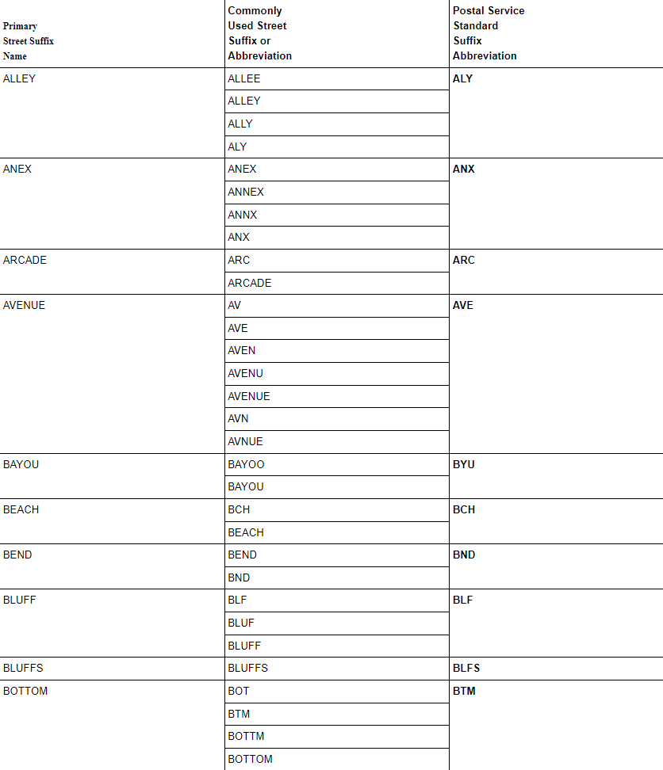
The first approach
The first way I intended to resolve this problem was by using a combination of brute force and regex.
I wanted to create a list of all possible street abbreviations (such as the one in the picture) and match it with text in all the different sites. Where the text was matched, a scraper would select all the information in the div containing the match and save it for further parsing of the address.

Slide 5
The problem?
As a human, I am not able to think of all the possibilities of annotating a street and so such method would miss some addresses for sure.

Slide 6
A more refined solution
After realizing that brute force was not an option, and neither regex was useful because the addresses can have multiple forms, hard to match with a single or even couple expressions, I turned to a popular algorithm in the realm of unsupervised machine learning: Clustering.
What was the idea behind this?
To train a clustering algorithm on a long list of div class names that could or could not contain address information. After successfully identifying said cluster, It would be easy to run each site component through it and check for the possibility of containing a location.
The flaw of such idea was supposing that class names have meaning and could be easily clustered. After a little research, I found out that libraries like React or Angular compile classes with random names, so this approach does not define a sollution.

Slide 7
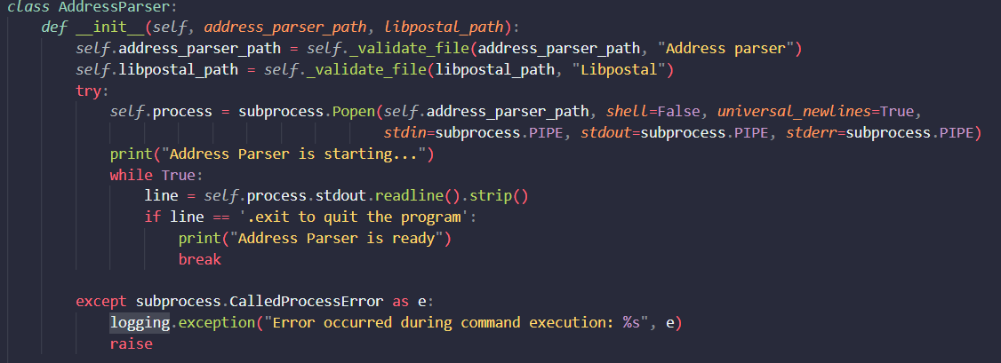
The best solution found
After a little research I stumbled over a library called “libpostal” that promises address parsing using NER (Named Entity Recognition). What does NER do? It is a natural language processing (NLP) method that extracts information from text. NER involves detecting and categorizing important information in text known as named entities. Named entities refer to the key subjects of a piece of text, such as names, locations, companies, events and products, as well as themes, topics, times, monetary values and percentages.
The problem was that “libpostal” was a library for C, so I found a wrapper on GitHub that would let me work with it in python(https://github.com/selva221724/pypostalwin). I tried it and was painfully slow. So, I modified the code to run smoother: The wrapper was opening a process every time I wanted to parse an address. I changed it to open a single process and run all the commands there.
I moved the process opening in the constructor of the class instead of leaving it in the parse_address() function.

Slide 8
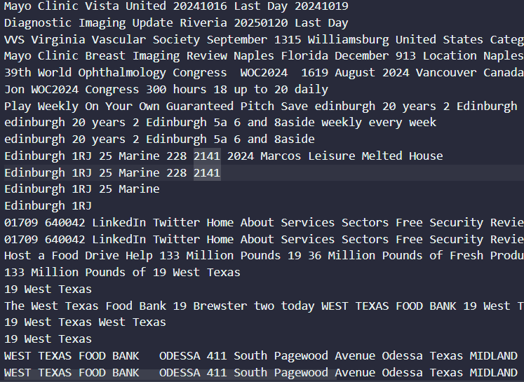
The pain continues
To my dread, this library was trained on a set of data containing isolated addresses, not ones in big chunks of text. So, the results were questionable at best…

Slide 9
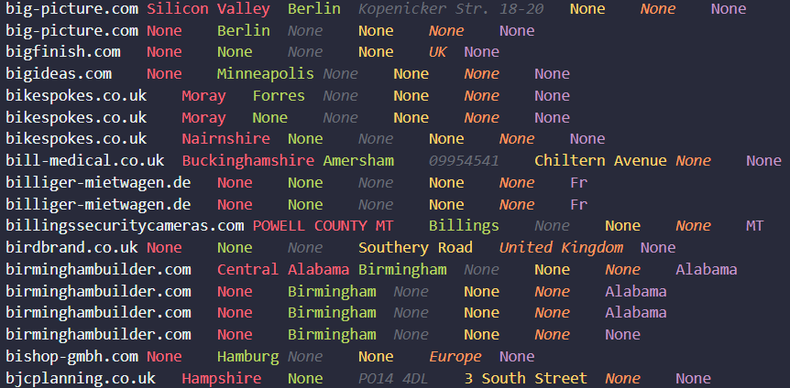
Hugging Face, the savior!
With a little bit more research, I found on Hugging Face a Named Entity Recognition Model named GLiNER (https://huggingface.co/urchade/gliner_base) capable of identifying any entity type using a bidirectional transformer encoder (BERT-like). It provides a practical alternative to traditional NER models, which are limited to predefined entities, and Large Language Models (LLMs) that, despite their flexibility, are costly and large for resource-constrained scenarios.
After implementing the model in my algorithm, I started getting better results! Albeit, with sparse information.

Slide 10
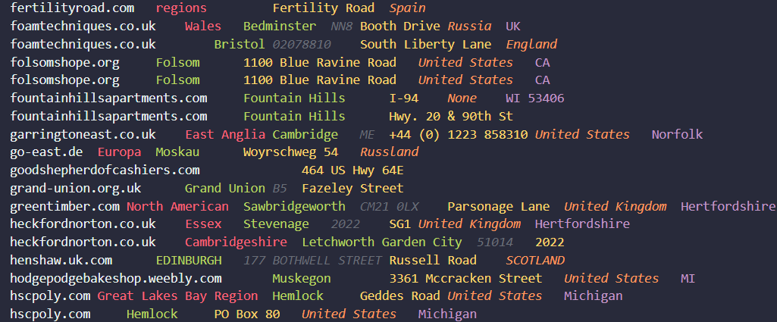
The next steps
I thought of a couple of ways of improving my application. The first one is trying to fill in the blanks with the help of the Geonames API. I created a function that would fill in the Country by searching the postal code or the state in their database. It’s still an experimental feature! (Not all findings are accurate)

Slide 11
Improving the algorithm
Another way is to train a NER algorithm from scratch (probably using SpaCy). The idea is to integrate an address database in site like structures and annotate the labels and their positions in the texts for the model to train on. Opting for such method would improve the accuracy and confidence of the found labels. This is a time and resource consuming process that I was not able to complete in such a short timespan. But I could elaborate a solution if asked.

Slide 12
Thank you for paying attention!

